Slide 1
Time Lag Aware Sequential Recommendation
Source : CIKM’22
Speaker : yang-YI, LIN
Advisor : Jia-Ling, Koh
Date : 2023/03/21

Slide 2
Outline
Introduction
Method
Experiment
Conclusion

Slide 3
Introduction
Sequential Recommendation Challenges
Unification of Stability and Fluctuation of Preferences
Book
Movie

Slide 4
Introduction
Sequential Recommendation Challenges
Unification of Stability and Fluctuation of Preferences
Fine-grained Fusion of Long-term and Short-term Preferences
0.3
0.7
Book
Movie
Book

Slide 5
Introduction
Time Lag aware Sequential Recommendations (TLSRec)
Unification of Stability and Fluctuation of Preferences
a hierarchical self-attention network
Fine-grained Fusion of Long-term and Short-term Preferences
a neural time gate based time lag

Slide 6
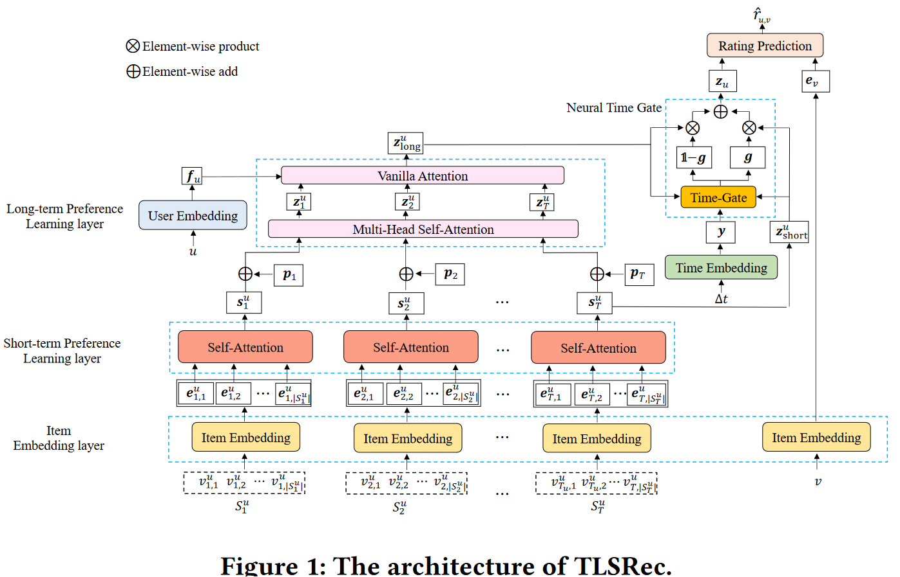
Method

Slide 7
Method
Input Data：
the historical session sequence of a specific user $u$ ：
$S^{u}=⟨S_{1}^{u}, S_{2}^{u}, · · · ,S_{T}^{u}⟩$
$S_{i}^{u}= \{v_{i,1}^{u},v_{i,2}^{u}, · · · ,v_{i,|S_{i}^{u}|}^{u}\}$
$v^{u}$：user u interact item
sessions are divided whenever the time interval between two interactions is more than a chosen threshold.

Slide 8
Method
Item Embedding layer
an M-dimensional one-hot vector to encode an item
Input：$S^{u}=⟨S_{1}^{u}, S_{2}^{u}, · · · ,S_{T}^{u}⟩$ , $S_{i}^{u}= \{v_{i,1}^{u},v_{i,2}^{u}, · · · ,v_{i,|S_{i}^{u}|}^{u}\}$
Output： item embedding $e_{i,j}^{u} ∈ R^{d}$

Slide 9
Method
Short-term Preference Learning layer
Input：item embedding $e_{i,j}^{u} ∈ R^{d}$
Output： session embeddings ${\text{s}}_{i}^{u} ∈ R^{d}$
using a Self-Attention

Slide 10
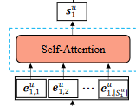
Method
Self-Attention (Short-term Preference Learning layer)

Slide 11
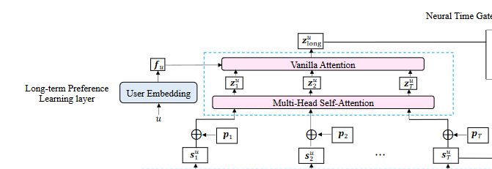
Method
Long-term Preference Learning layer
Multi-Head Self-Attention
→ fuse local preferences of user
Vanilla Attention
→ fuse user and feature of global preference

Slide 12
Method
Multi-Head Self-Attention (Long-term Preference Learning layer)
Input： ${\text{s}}_{i}^{u}+ p_{i}= {\hat{s}}_{i}^{u}∈ R^{d}$ , $p_{i}$is learnable position embedding

Slide 13
Method
Vanilla Attention (Long-term Preference Learning layer)
Input： user embedding $f_{u}∈ R^{d}$ , $z_{i}^{u}$ $∈ R^{d}$
Q
K
V

Slide 14
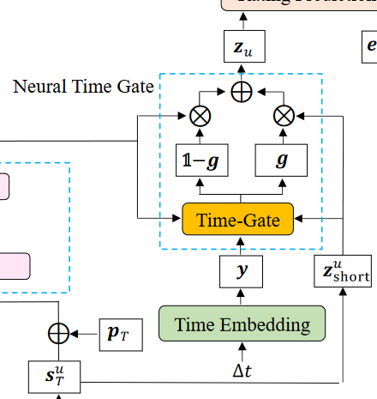
Method
Neural Time Gate
Input：
short-term preference embedding $z_{short}^{u}= s_{T}^{u}$ (the last session embedding),
long-term preference embedding $z_{long}^{u}$ ,
time lag $∆t$ (the time between last interaction and recommendation)

Slide 15
Method
Neural Time Gate
discretized time lag δ
$∆min$ ： minimum time gap between any two interactions of a give user

Slide 16
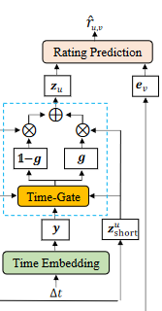
Method
Neural Time Gate
the normalized gating vector $g$

Slide 17
Method
Loss function

Slide 18
Experiment
Data Set
Session time gap threshold
Amazon Book、Amazon Video：2 days
MovieLens-1M、Lastfm：2 hours

Slide 19
Experiment
Evaluation Metrics
Hit rate
MAP (Mean Absolute Precision)

Slide 20
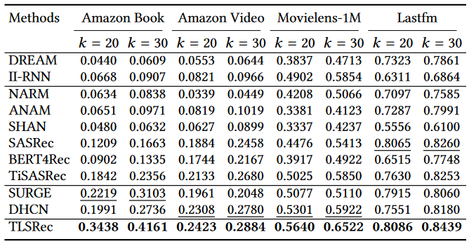
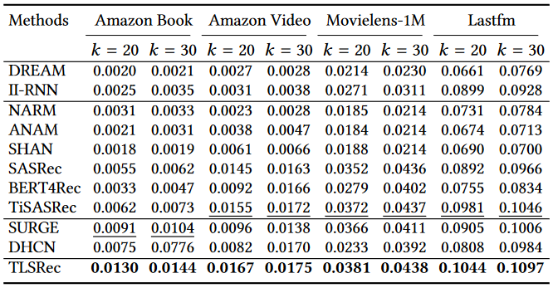
Experiment
Performance Comparison with Baselines
RNN
Attention
GNN

Slide 21
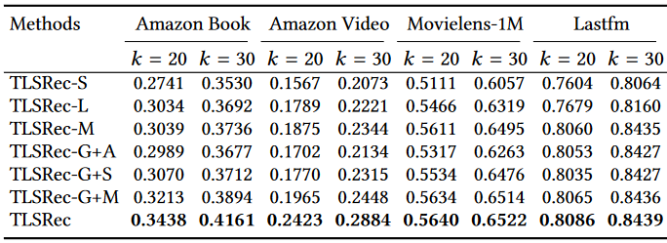
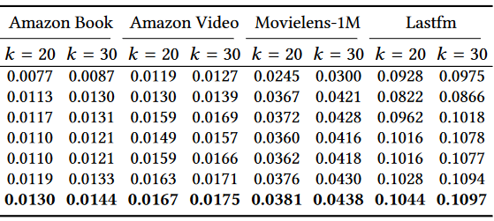
Experiment
Ablation Experiments

Slide 22
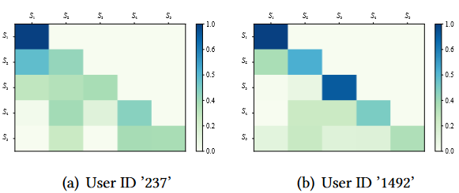
Experiment
Case Study
Visualization of the self-attention coefficients between sessions (long-term)

Slide 23
Experiment
Case Study
Visualization of the time gate vectors $g$

Slide 24
Conclusion
A hierarchical self-attention network to unite the learning of the
long- term preference and short-term preference
A neural time gate to fine-grained fusion of the long-term preference
and short-term preference at the dimension level

